Slide 1
GIT Session

Slide 2
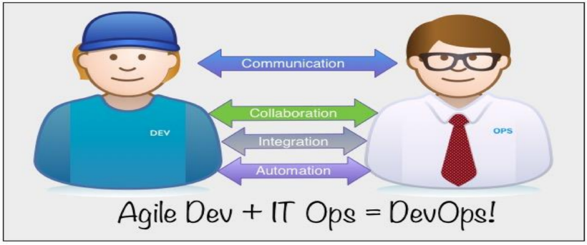
Devops overview

Slide 3
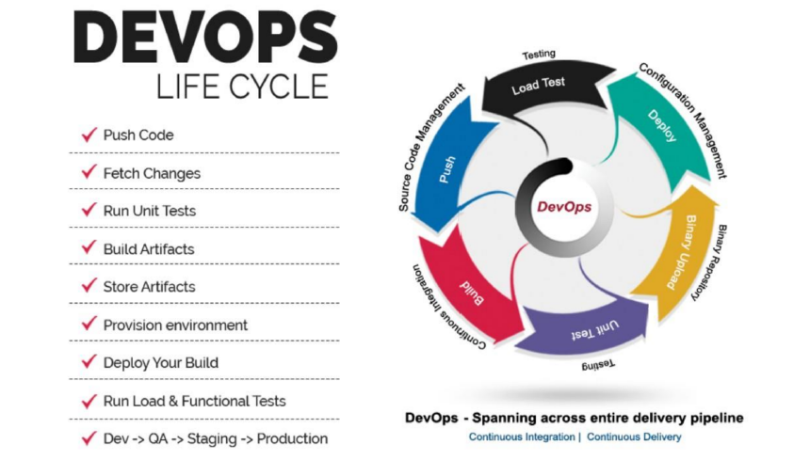

Slide 4
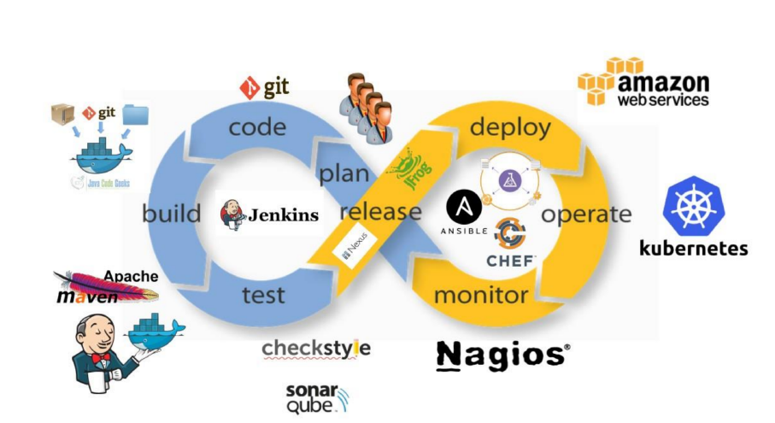
MOM
Devops Tools overview

Slide 5




















Assess Tech & Tool
Landscape
Assess Future Technology Roadmap
Map Tool Features and Identify Gaps
Identify
Opportunities for Seamless Toolchain
Define Tool Roadmap with Existing & New tools (if any)
Optimized & Integrated Enterprise, Open Source & Vendor Tools
Approach to optimize tool set
Requirements & Design
Source Code
Build/Package &
Continuous Integration
Unit Testing
Code Quality/Security & Artifact Repo
Cloud Services Platform
Non Production Environment
Cognizant DevOps Framework
Deploy to NPE Environment
InsightsTM | BuildOn | ExtendCD | OnBot
Log Tickets
Monitoring & Feedback
Update CMDB
Deploy to
Production
Release Mgmt
Approvals
Integration &
Functional Testing
ELK

Slide 6




Agenda
Overview of Version control
GIT overview
Common terminologies
Process Flow
Simple Day to day GIT workflow
GIT Installation
GITHUB tool demo
References/Resources
Q&A Session

Slide 7
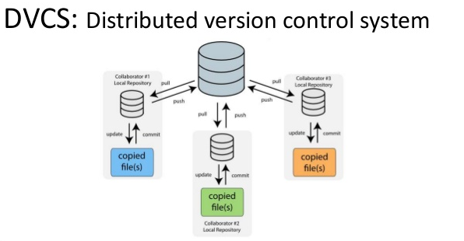
Overview of Version control
Why we need Version control
Allows developers to work simultaneously.
Does not allow overwriting each other’s changes.
Maintains a history of every version.
Historical view
Single or Local File
Centralized version control system (CVCS). E.g.: SubVersion
Distributed/Decentralized version control system (DVCS) E.g.: GIT, Bitkeeper, Mercurial
Advantages of DVCS
Implicit backup
Security
No need of powerful hardware
Very minimal usage of Server (Only needed for Push/Pull)
Easier branching

Slide 8
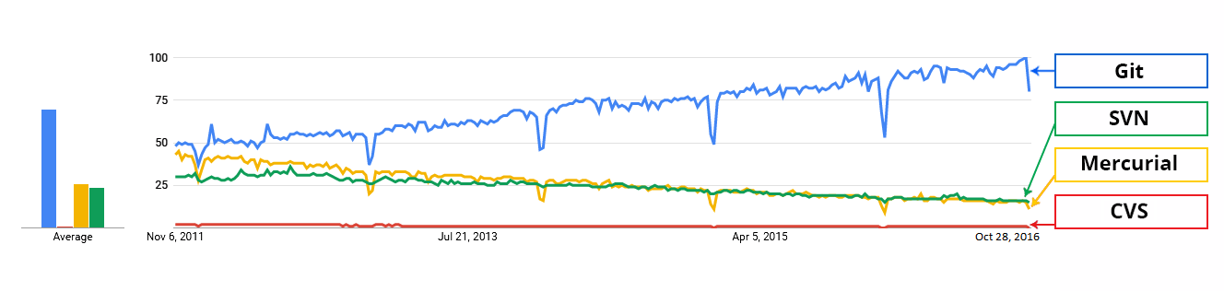

Slide 9
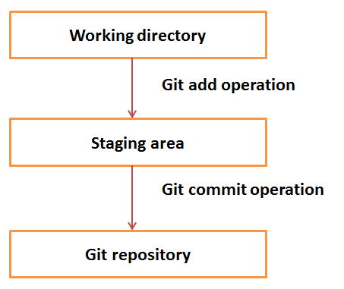
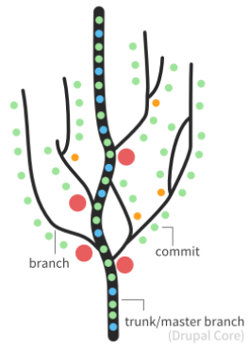
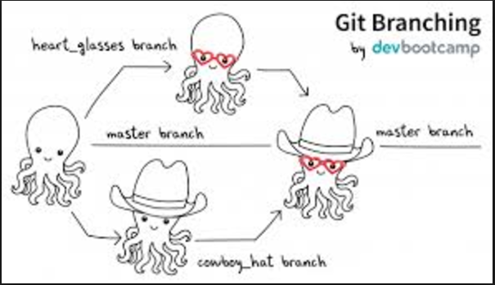
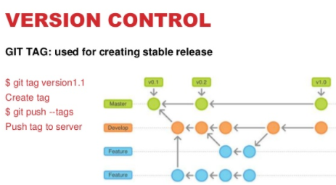
GIT Overview – Common Terminologies
Local Repository
Working Directory
Index or Staging Area
Remote Directory
Other terminologies
Clone
Push
Pull
HEAD
Branches
Trees
Commits

Slide 10
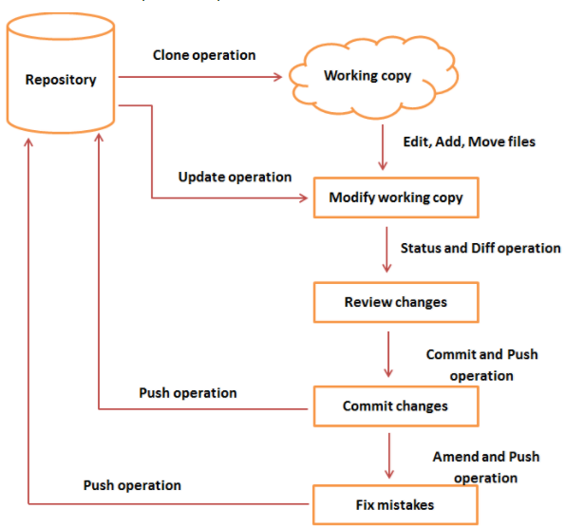
GIT – Process Flow
Source: Tutorials point.com

Slide 11
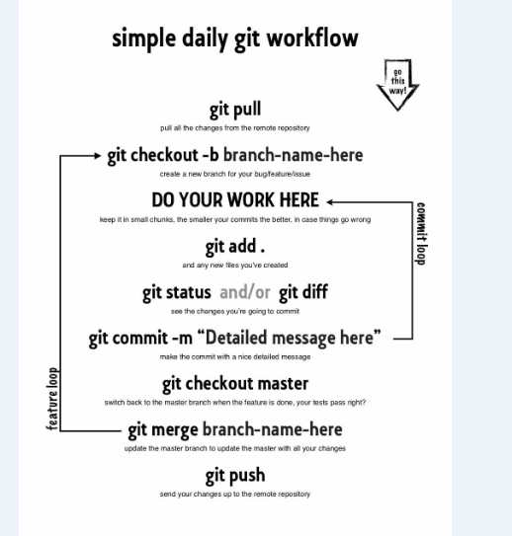
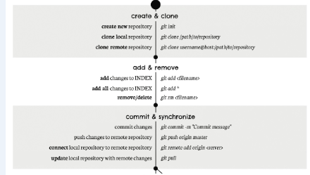
GIT Overview – A Day to Day Workflow
Source: Google, Pinterest

Slide 12
GIT Installation
Linux(Ubuntu) - sudo apt-get install git
Linux(RedHat) - sudo yum install git
Windows - GIT for Windows , Tortoise GIT
MAC - Xcode, apple-GIT

Slide 13
What’s the plan for today?
Version Control - Concepts, Terminology
Git – Commands
Collaborating with Git using GitHub
Version Control practices and workflow in the industry.
Notes:
This talk is divided into few smaller chunks.
First we will establish the need of a versioning system and tools and the problem it solves
Then we’ll see how git can be used to track codebase changes and also collaborate
Best practices used in industry.

Slide 14
Version Control with Git and GitHub

Slide 15
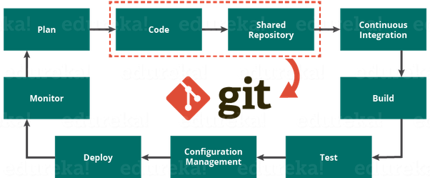

Slide 16
Why version control?
Makes working in a team easy!
Code without interference.
Go back to a previous version (iOS 10 anyone?)
Integrate code of multiple developer’s easily.
Know who did what, when.
Keep your code secure.

Slide 17
How do you work with other developers?
Work in a team, probably on particular components ?
Integrate your code together.
Make copies of your files in case something you lose them. (Not really?)

Slide 18
How do you work with other developers?
Work in a team, probably on particular components ?
Integrate your code together.
Make copies of your files in case something you lose them. (Not really?)

Slide 19
Git Installation
Things you’ll need:
You need Git installed on your system, and you can access it in a UNIX Terminal, either the Terminal on the Mac or Git Bash on Windows.
Download Git from the following link:
https://git-scm.com/downloads
Windows
Linux
Mac

Slide 20
Version Control Terminology
Version Control System (VCS) or (SCM)
Repository
Commit
SHA
Working Directory
Checkout
Staging Area/Index
Branch

Slide 21
Version Control Terminology
Version Control System :
A VCS allows you to: revert files back to a previous state, revert the entire project back to a previous state, review changes made over time, see who last modified something that might be causing a problem, who introduced an issue and when, and more.
Repository:
A directory that contains your project work which are used to communicate with Git. Repositories can exist either locally on your computer or as a remote copy on another computer.

Slide 22
Version Control Terminology
3. Commit
Git thinks of its data like a set of snapshots of a mini file system.
Think of it as a save point during a video game.
4. SHA
A SHA is basically an ID number for each commit.
Ex. E2adf8ae3e2e4ed40add75cc44cf9d0a869afeb6
5. Working Directory
The files that you see in your computer's file system. When you open your project files up on a code editor, you're working with files in the Working Directory.

Slide 23
Version Control Terminology
6. Checkout
When content in the repository has been copied to the Working Directory. It is possible to checkout many things from a repository; a file, a commit, a branch, etc.
7. Staging Area
You can think of the staging area as a prep table where Git will take the next commit. Files on the Staging Index are poised to be added to the repository.
8. Branch
A branch is when a new line of development is created that diverges from the main line of development. This alternative line of development can continue without altering the main line.

Slide 24
Let’s dive into the good stuff now
GIT COMMANDS:
(THINGS WE’LL COVER)
BASIC GIT COMMANDS
REMOTE REPOSITORY – PUSH & PULL
BRANCHING, TAGGING AND MERGING
DISASTER HAS STRUCK!

Slide 25
Basic Git Commands
git init
git status
git add <filename> / git add .
git commit / git commit –m “commit message”
git log –oneline / git log —stat
git clone
Other commands like git show, git ignore, git diff etc.

Slide 26
Feature of Git
Free and Open Source
Speed
Scalable
Reliable
Secure
Economical
Supports non-linear development
Easy branching
Distributed development
Compatability with existing system or protocol

Slide 27
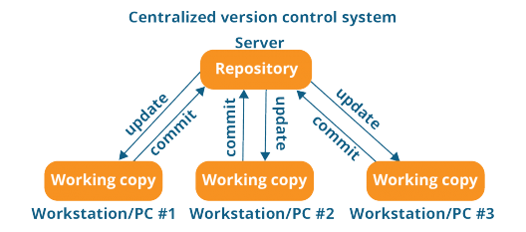

Slide 28
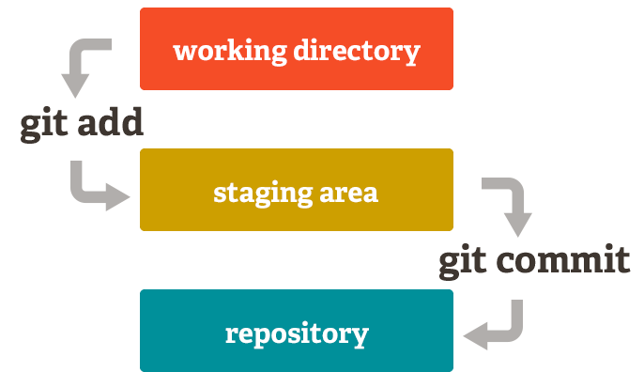
Basic Git model locally

Slide 29
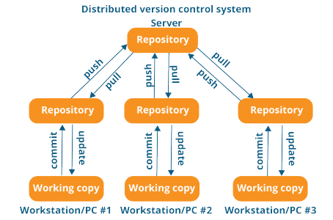

Slide 30
Basic Git Commands
git init – Initialize a Git repository/working directory
git status – Status of your working directory
git add <filename> or git add . (for all files in your working directory)
git commit – Stash changes in your working directory
git log –oneline – View your commit history
git clone – Create an identical copy

Slide 31
git config
git init
git clone
git add
git commit
git diff
git reset
git status
git rm
git log
git show
git tag

Slide 32
git branch
git checkout
git merge
git remote
git push
git pull
git stash

Slide 33
GitHub
It’s a hosting medium/website for your Git repositories
Offers powerful collaborative abilities
A good indicator of what you code/how much you code/quality of your code

Slide 34
Working with a remote repository
Remote?
It’s the place where your code is stored.
By default, remote name is origin and default branch is master.
Certain things that come to play, namely collaboration.
How are we going to handle that with Git.
So here comes, push, pull, branching, merging, forking.

Slide 35


Alice
Notes:
Alice builds a semi-calculator app that just adds and subtracts numbers. And saves it to local directory

Slide 36

Alice
Bob
Notes:
Bob also designs a calculator that can multiply and divide numbers. And adds one more file to it.

Slide 37
Alice
Bob
Joe
Notes:
The genius Average Joe changes all the file thinking the calculators were wrongly designed. Hence, changes everything and replaces the files in directory.

Slide 38


Alice
Bob
Joe
Who replaced the files? When ?
Notes:
Over the weekend everyone thinks they have created a great calculator and which safely resides in directory. But on Monday nobody knows who made the change to the files.
Joe is too drunk to realize he was the one who replaced the files!. Perfect Recipe for disaster.

Slide 39
How to access GitHub
Access it on github.com
Create an account if you don’t already have one.
GitHub Clone link:
github.com/intley/Version_Control_Workshop

Slide 40
GitHub Demo

Slide 41
More Git commands
git push – push your changes into the remote repository
git pull – pull your latest changes from the remote repository
git branch – view branches in your repository
git branch <branchname> - create a branch
git checkout <branchname> - move to that branch
git merge <branchname> - merge into that branch
git revert <commit sha>

Slide 42
Demo

Slide 43
Collaboration with GitHub
Remote Repo
Master
C1
Alice
Bob
C2

Slide 44
Collaborate
Remote Repo
git clone
git clone
Master
Master
Master
C1
C1
C1
Alice
Bob
C2
C2
C2

Slide 45
Collaborate
Remote Repo
Master
Master
Master
C1
C1
C1
Alice
Bob
C2
C2
C2
CA
git add
git commit
CB
git add
git commit

Slide 46
Collaborate
Remote Repo
Master
Master
Master
C1
git push
C1
C1
Alice
Bob
C2
C2
C2
CA
C3
CB

Slide 47
Collaborate
Remote Repo
Master
Master
Master
C1
C1
git fetch
C1
Alice
Bob
C2
C2
C2
C3
CA
C3
CB

Slide 48
Collaborate
Remote Repo
Master
Master
Master
C1
C1
git merge
C1
Alice
Bob
C2
C2
C2
CA
C3
C3
CB

Slide 49
Collaborate
Remote Repo
Master
Master
Master
C1
C1
git push
C1
Alice
Bob
C2
C2
C2
CA
C3
C3
CB
CB

Slide 50
Collaborate
Remote Repo
Master
Master
Master
C1
git pull
C1
C1
Alice
Bob
C2
C2
C2
CA
C3
C3
CB
CB
CB

Slide 51
More on Collaborative Git commands
Deleting a branch
git branch –d <branchname>
Merge conflicts! How do you resolve?
Pull requests ?
git tag –a v1.0 / git tag –a v1.0 <commit sha>

Slide 52
Dealing with Merge Conflicts
Two typical cases of merge conflicts
Normal merge where you’re a collaborator
Pull request (handled by the repository owner)

Slide 53
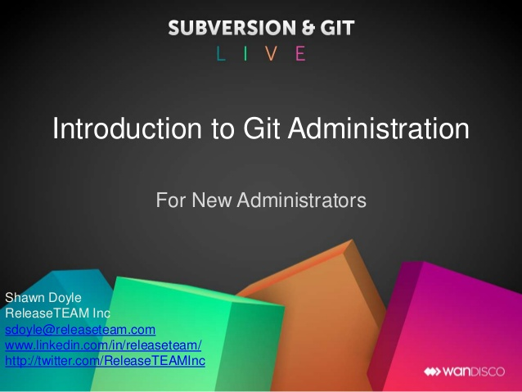

Slide 54
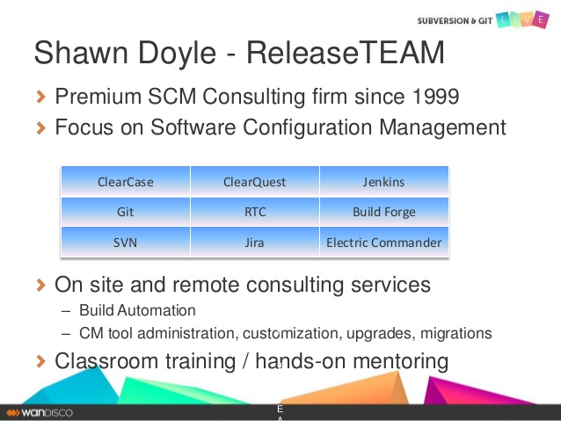

Slide 55
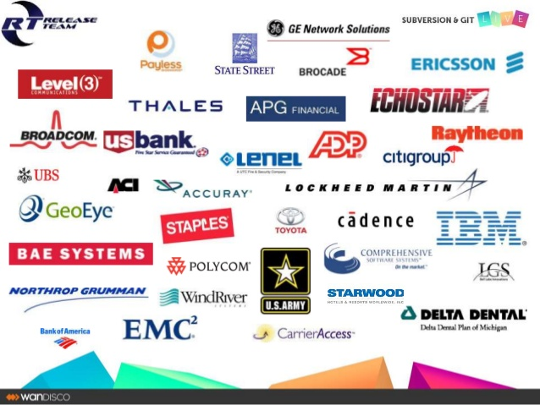

Slide 56
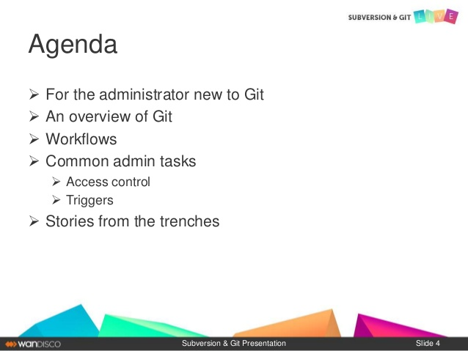

Slide 57
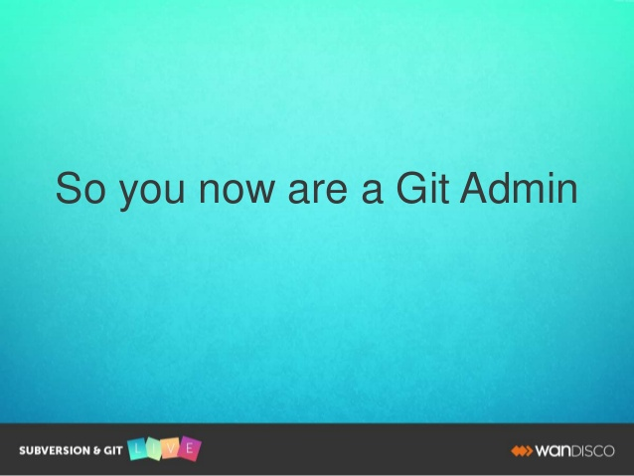

Slide 58
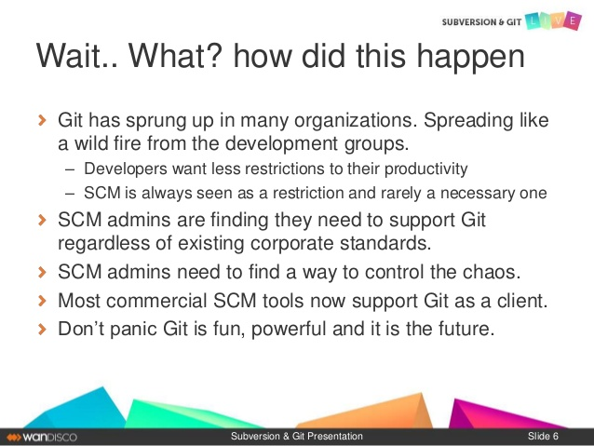

Slide 59
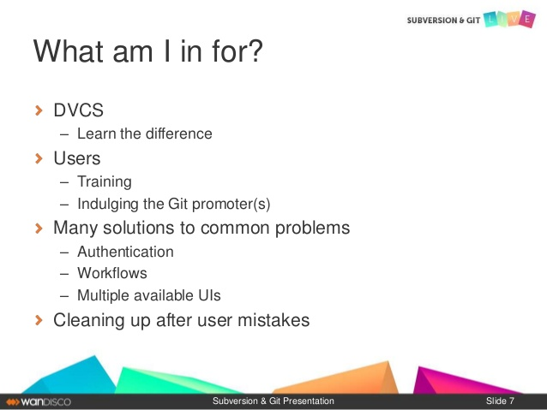

Slide 60
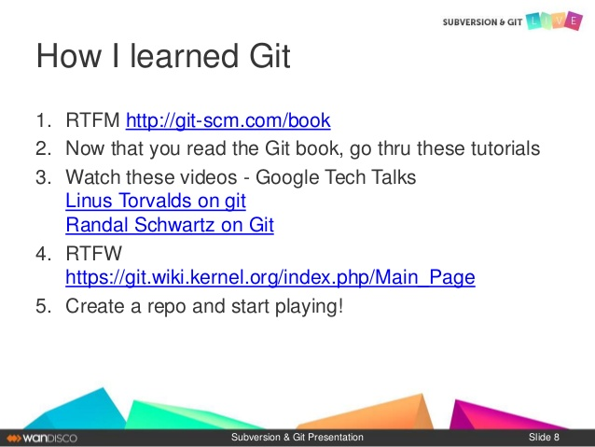

Slide 61
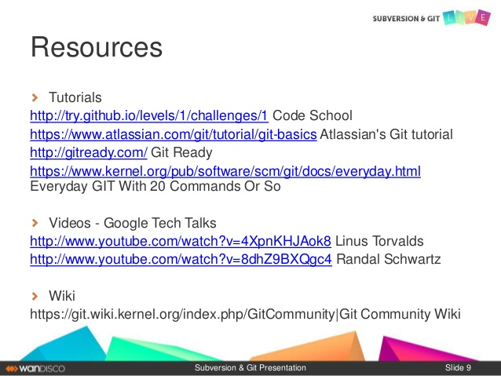

Slide 62
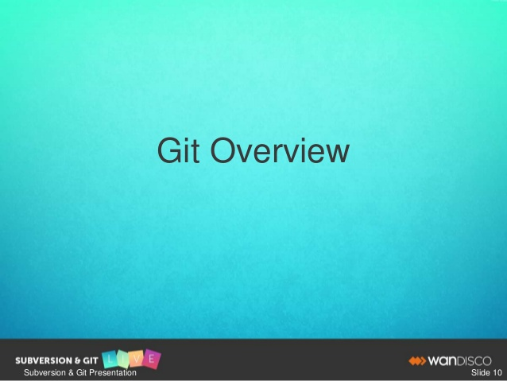

Slide 63
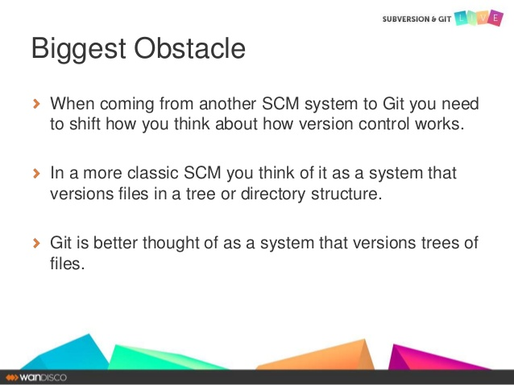

Slide 64
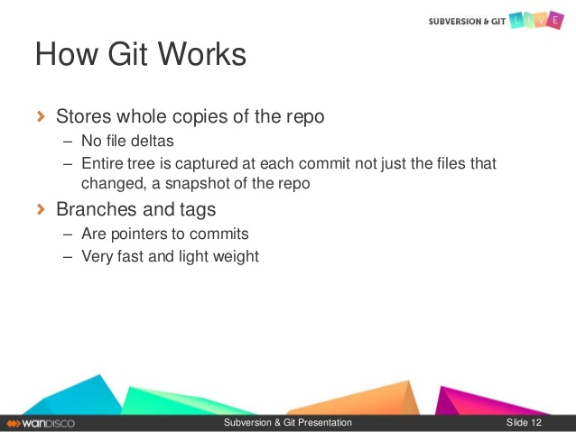

Slide 65
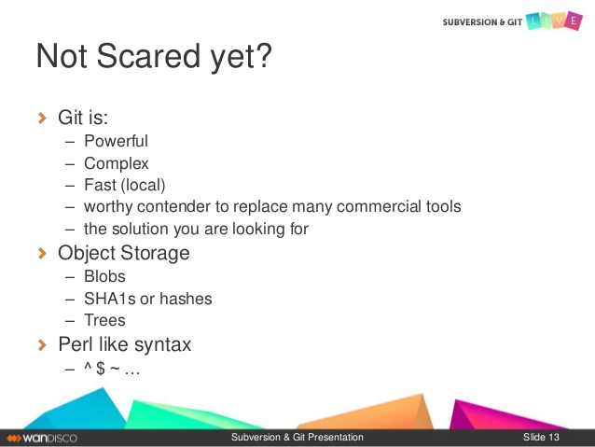

Slide 66
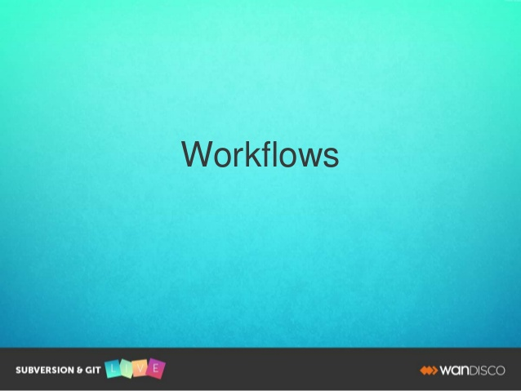

Slide 67
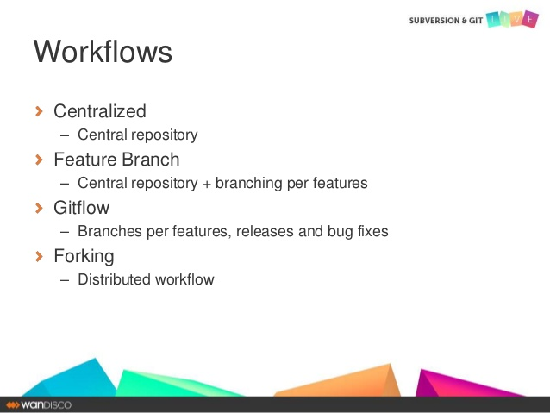

Slide 68
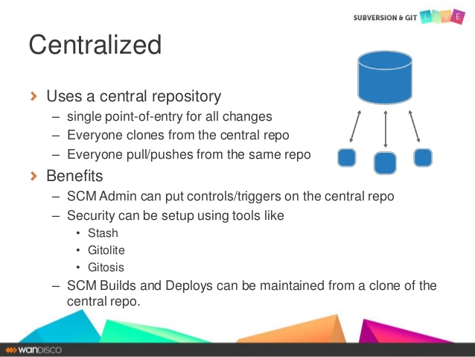

Slide 69
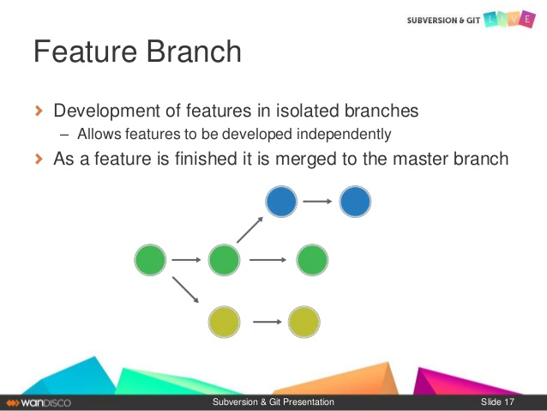

Slide 70
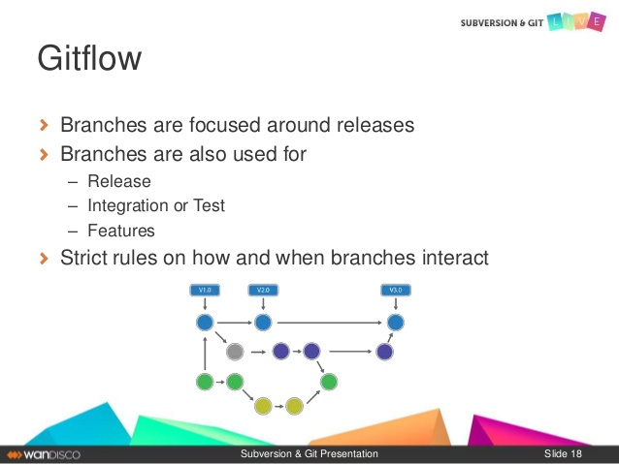

Slide 71
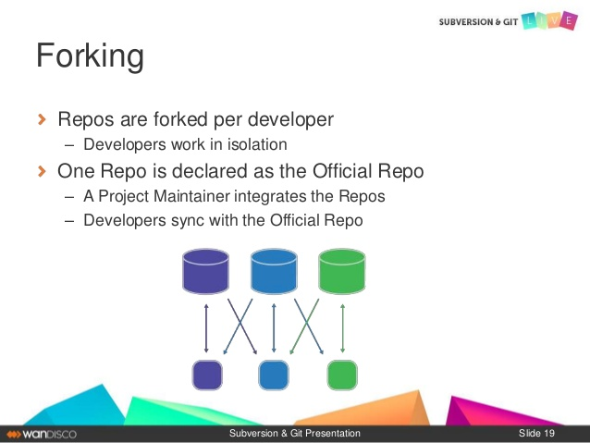

Slide 72
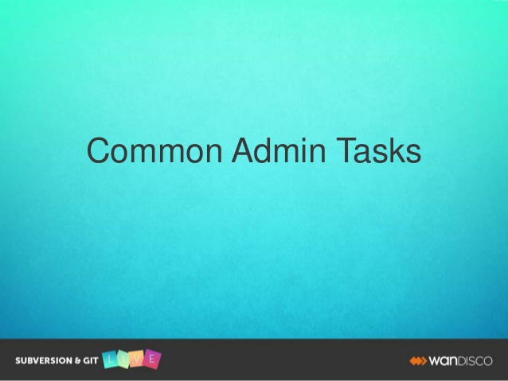

Slide 73
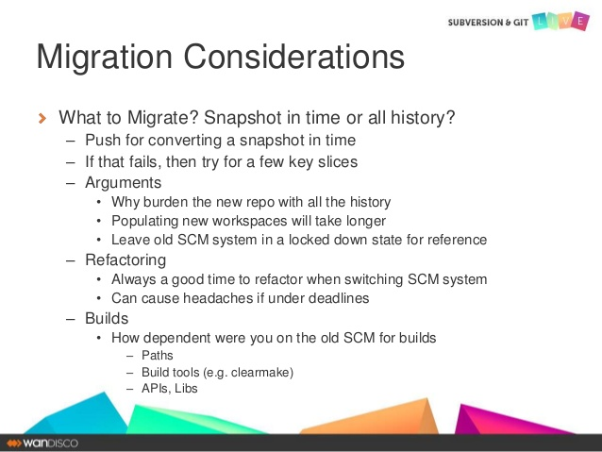
GitHub

Slide 74
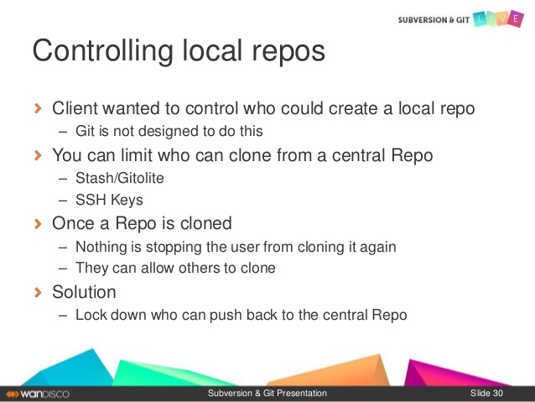

Slide 75
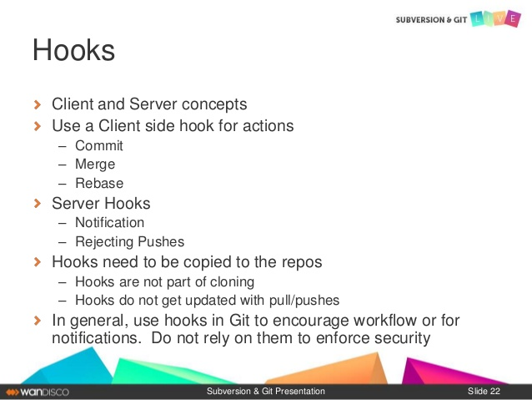

Slide 76
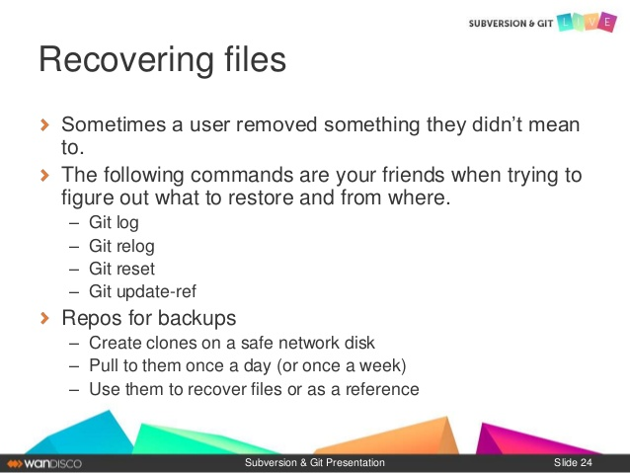
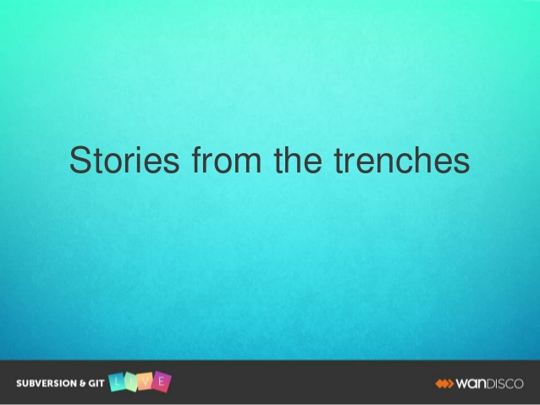
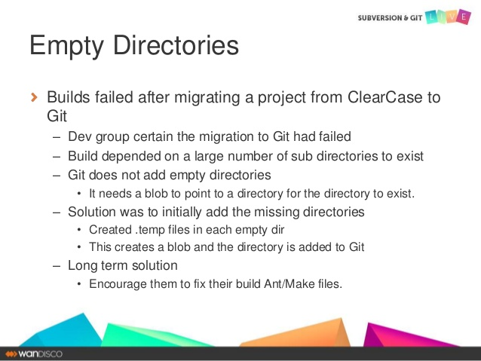
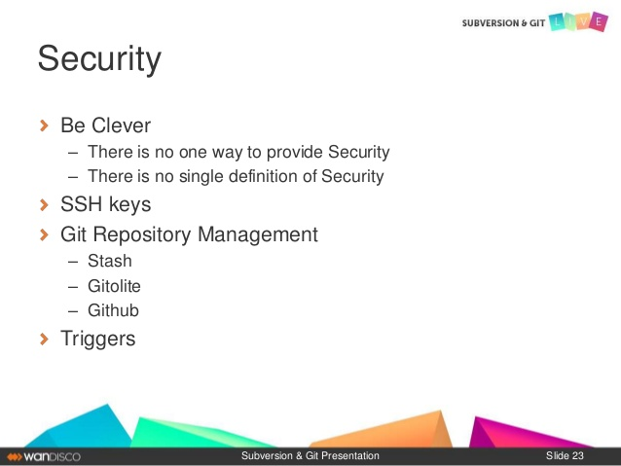

Slide 79
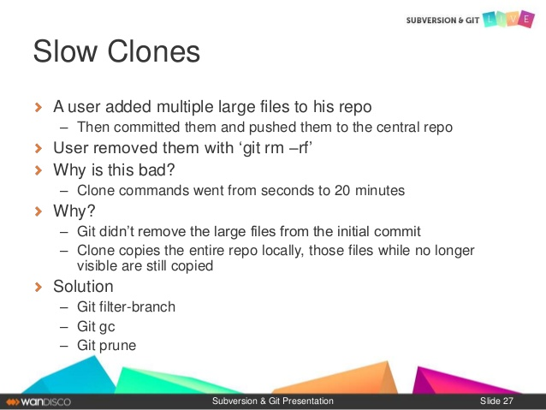

Slide 80
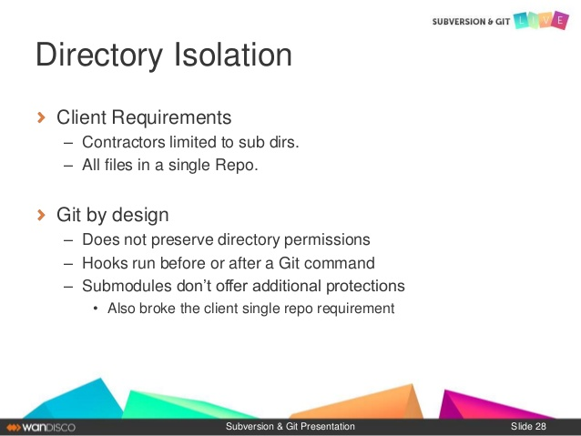

Slide 81
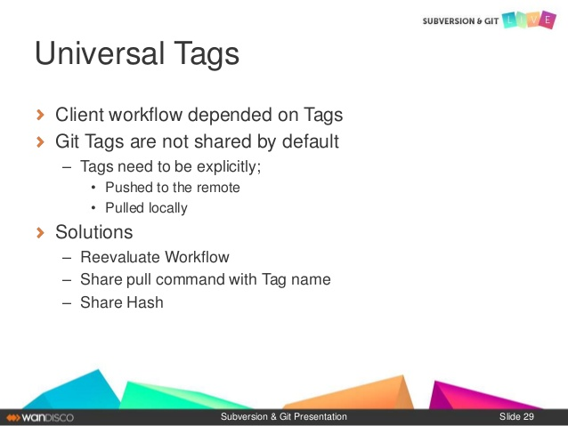

Slide 83
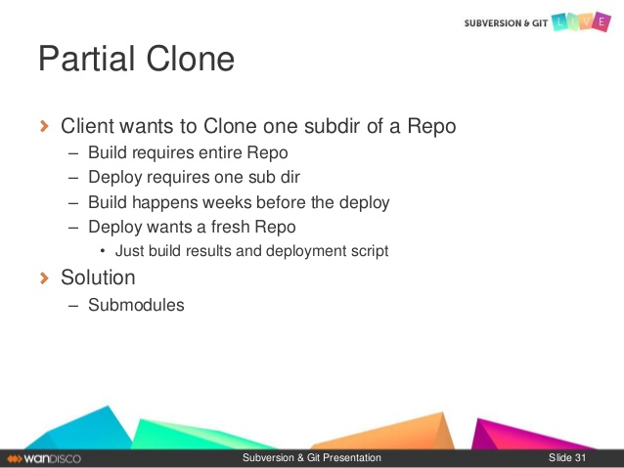

Slide 84
Basic Git Commands
git init
git status
git add <filename> / git add .
git commit / git commit –m “commit message”
git log –oneline / git log —stat
git clone
Other commands like git show, git ignore, git diff etc.

Slide 85
Access permissions on GitHub
While you can grant read/write access to collaborators on a personal repository, members of an organization can have more granular access permissions for the organization's repositories.
https://help.github.com/en/articles/permission-levels-for-a-user-account-repository

Slide 86
Thank you

Slide 87
